Slide 1
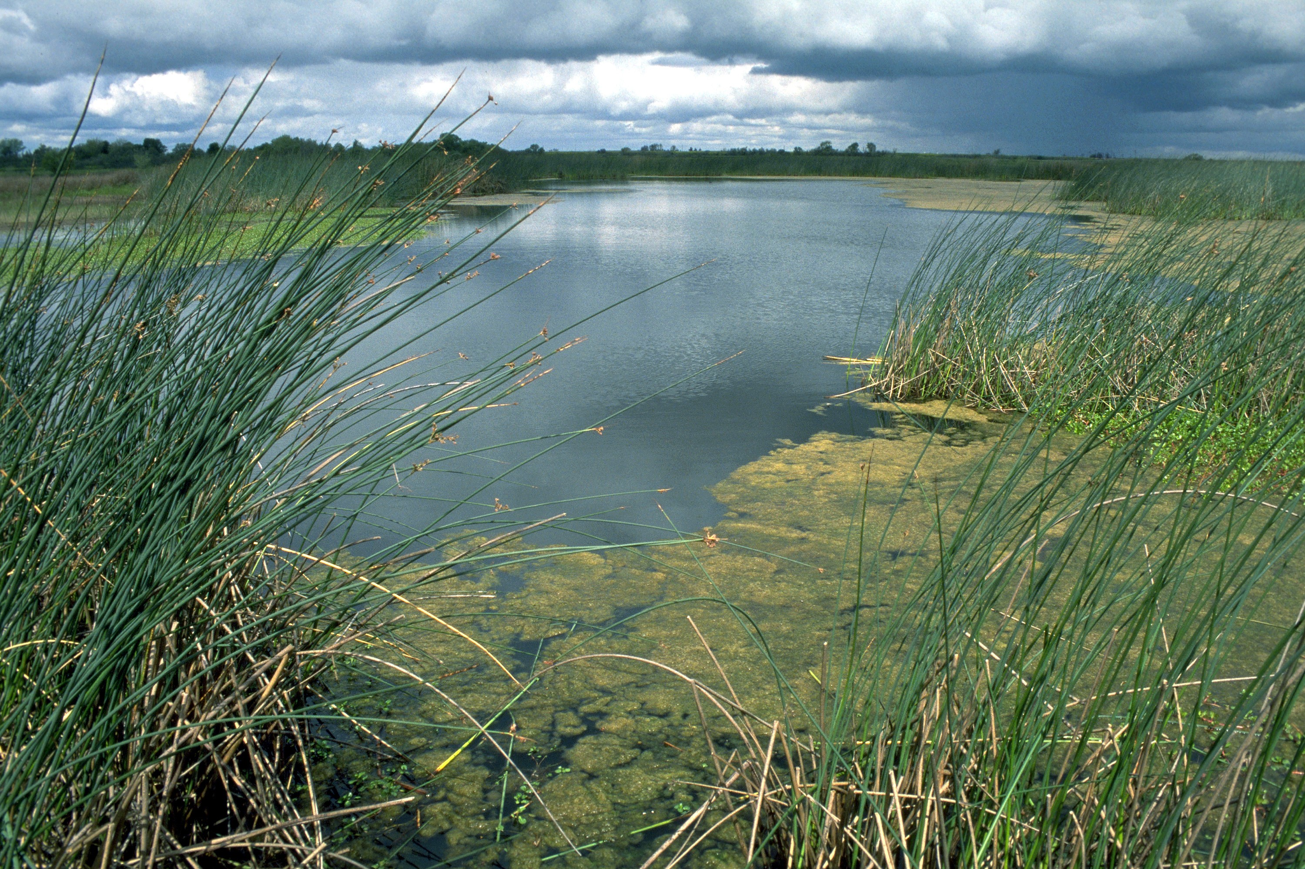
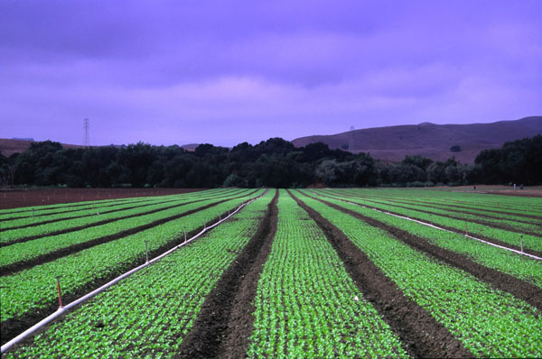
The Farm Bill

Slide 2
2008 & 2014 Farm Bill Spending
$ in billions | 2008 | 2014
Total | $604 | $956
Nutrition | $406 | $756
Crop Insurance | $47 | $89
Conservation | $55 | $58
Commodity Programs | $86 | $45
All Other | $10 | $8

Slide 3
2014 Farm Bill: A bountiful harvest
$1 Trillion over 10 years
  80% Nutrition (“food stamps”)
  20% Agricultural programs
$58 Billion for conservation programs over 10 years
  $19 B for temporary land retirement
  $17 B for stewardship enhancement contracts
  $16 B for environmental quality projects
    5% for wildlife
  $3 B for easements
  $1 B for regional conservation partnerships

Slide 4
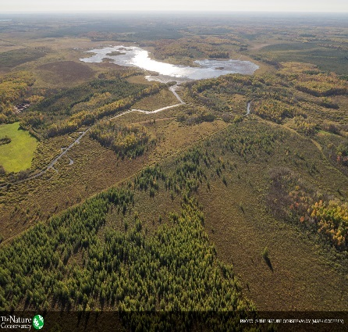
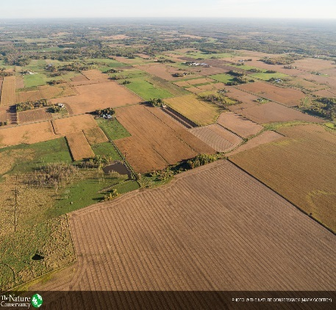
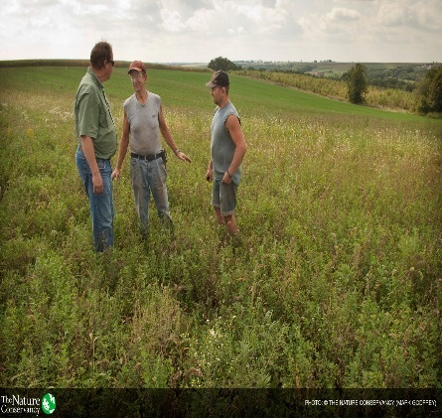
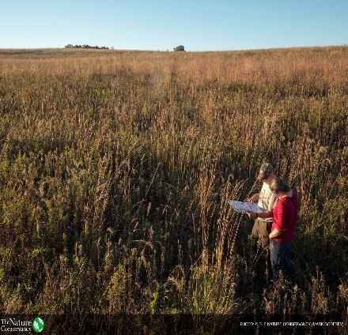
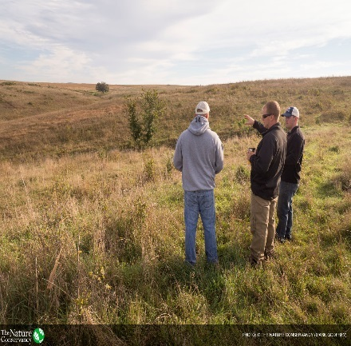
USDA Conservation Programs
Agricultural Conservation Easements Program (ACEP)
-ALE
-WRE
Environmental Quality Incentives Program (EQIP)
Conservation Reserve Program (CRP)
Conservation Stewardship Program (CSP)
Regional Conservation Partnership Program (RCPP)

Slide 5
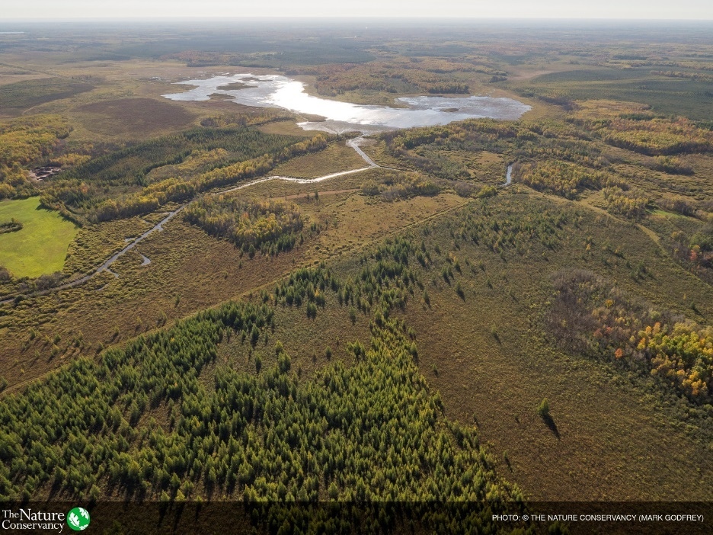
Conservation Reserve Program
Total acre enrollment lowered to 24 million acres by 2018
  Current cap at 32 million acres with roughly 27 million acres enrolled
Of the 24 million, 2 million acres for grassland
Allows some early terminations

Slide 7
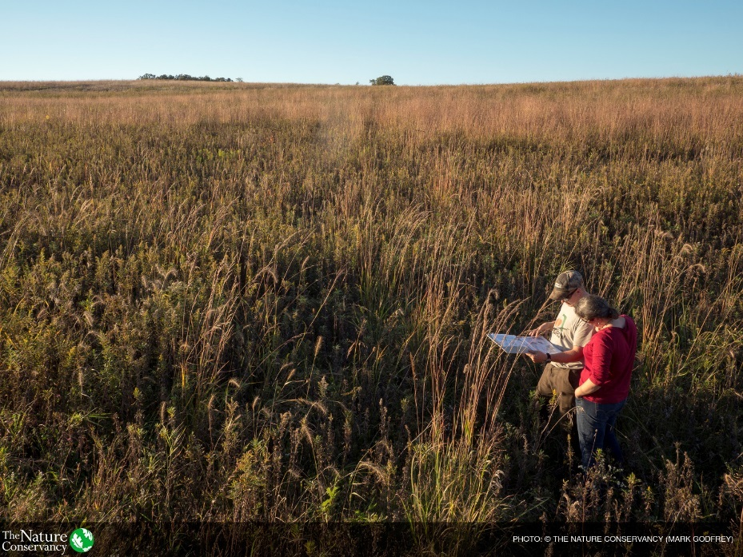
Environmental Quality Incentives Program
WHIP merged into EQIP
  At least 5% of total funding for wildlife
Funding:
  $1.35 billion FY14
  $1.6 billion FY15
  $1.65 billion FY16 and FY17
  $1.75 billion FY18
Contract limit of $450,000 (FY14 – FY18)

Slide 8
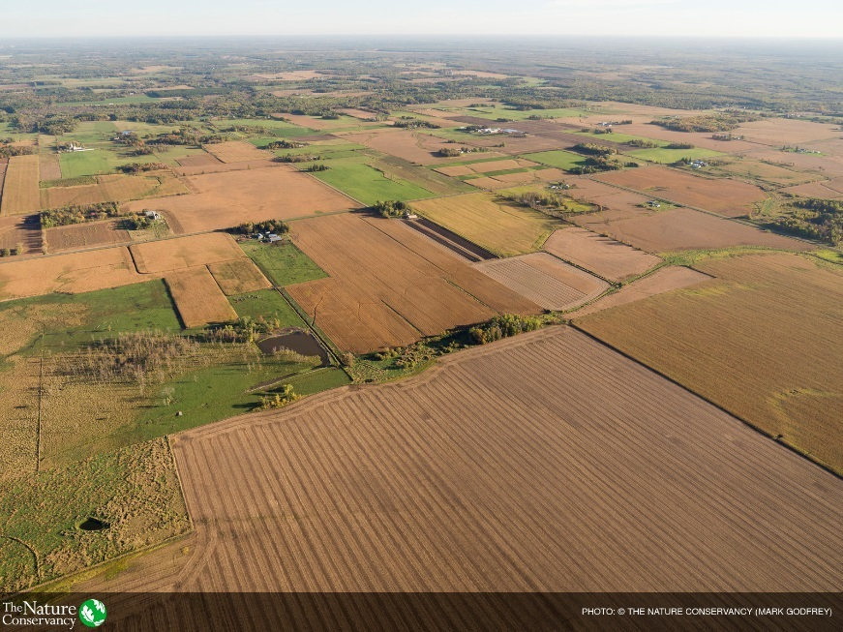
Conservation Stewardship Program
5 year contract with $200,000 payment limit
Farm operators are eligible, non-operating landlords are not
Payments made on existing conservation practices (maintenance) and for “enhancements” or new conservation practice
Must meet 2 “resource concerns” to be eligible

Slide 9
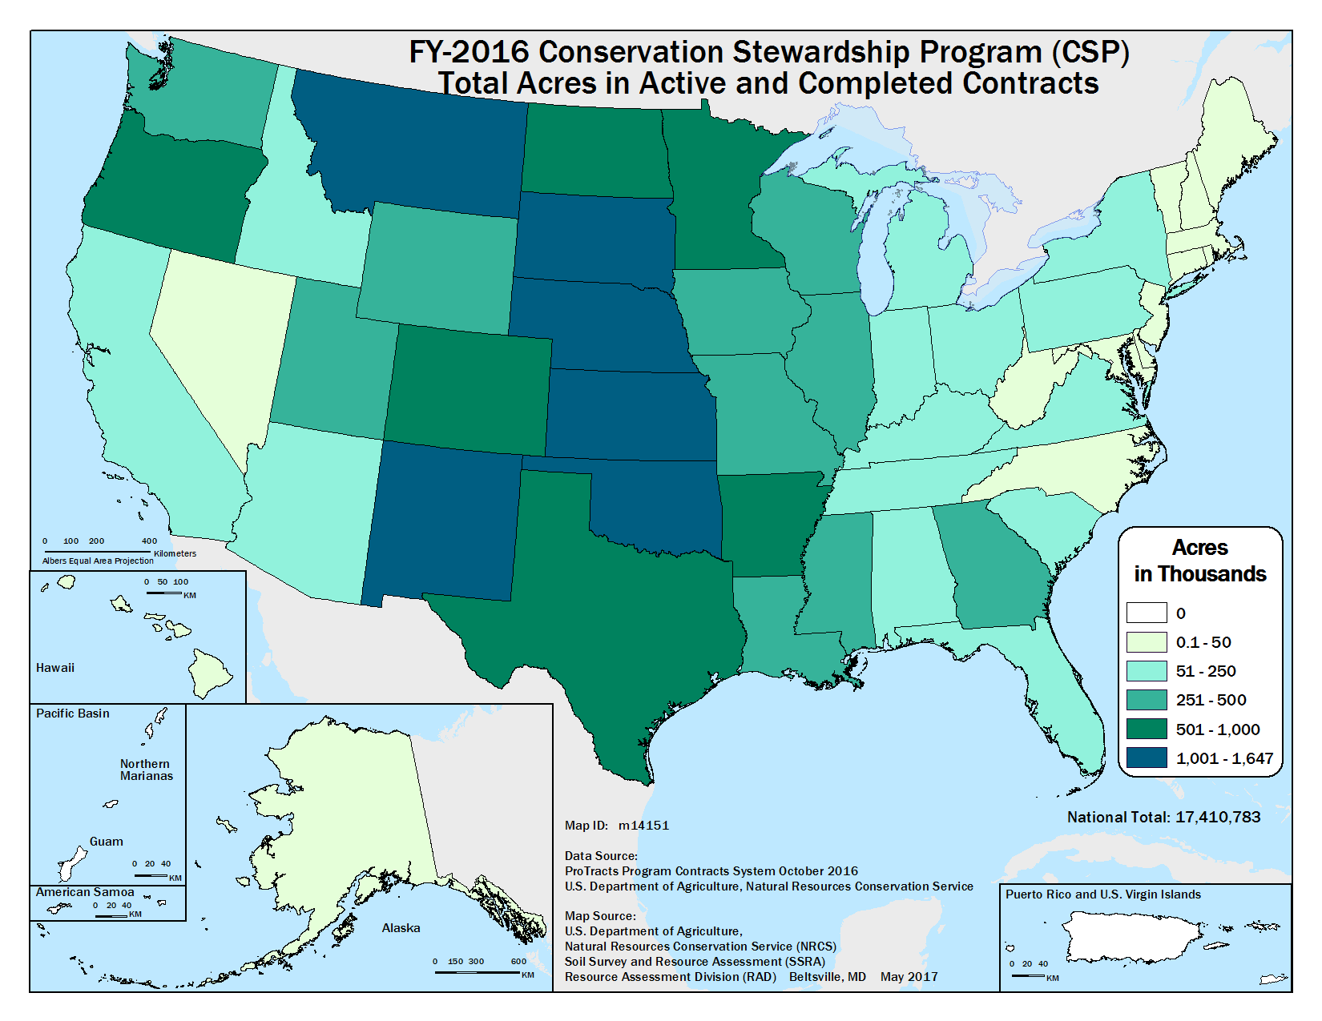

Slide 10

Agricultural Conservation Easement Program
ACEP – one easement program with two legs
  Agriculture Land Easements (ALE)
  Wetland Reserve Easements (WRE)
Funding:
  $400 million FY14
  $425 million FY15
  $450 million FY16
  $500 million FY 17
  $250M FY18, which establishes a permanent baseline for easements
States to decide how much for ALE v WRE

Slide 11
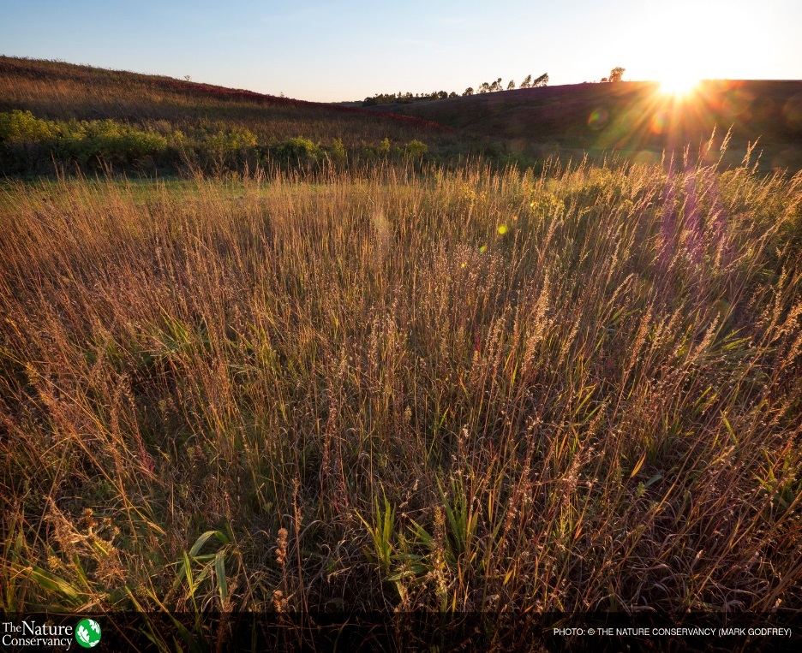
Agricultural Land Easement
Delivered by “eligible entities”
Cropland, rangeland, grassland, pastureland, and nonindustrial private forestland
50% cost share by Secretary of FMV
  75% for grassland of “special environmental significance”
Non-federal share at least equal to Secretary’s contribution

Slide 12
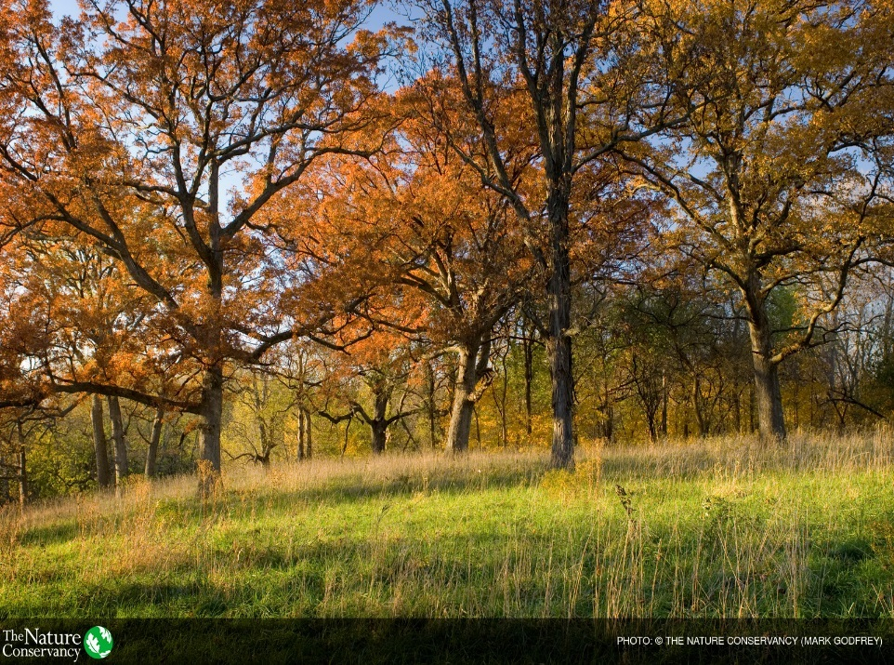
Agricultural Land Easement
Non-federal share – landowner donation up to 50% of non-federal share (25% of total)
  Secretary may waive landowner donation limit for projects of special significance and property is in active agricultural production
Valuation – appraisal (USPAP) or area-wide market analysis survey or other industry approved method
Eligible entity able to use its easement terms as long as meets minimum NRCS requirements

Slide 13
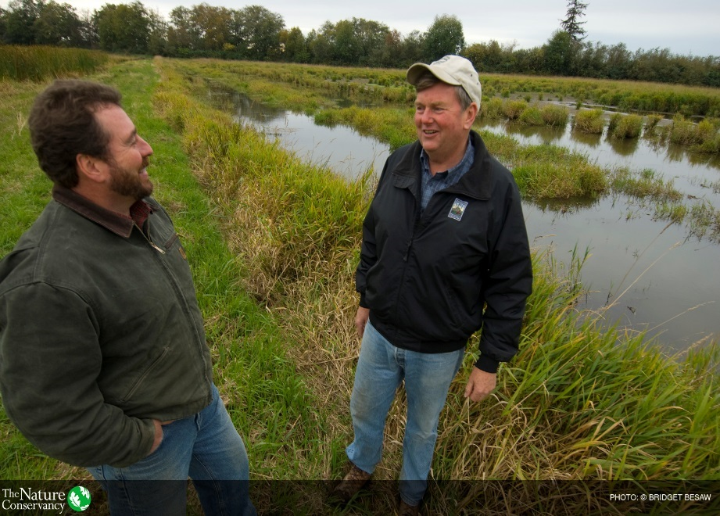
Wetland Reserve Easements
Basically old WRP
100% Federal easement administered by NRCS
2 year ownership requirement
Reservation of grazing rights (no longer a pilot)
Wet and saturated soils (subclass within land capability IV – VIII) no longer count towards county cap

Slide 14
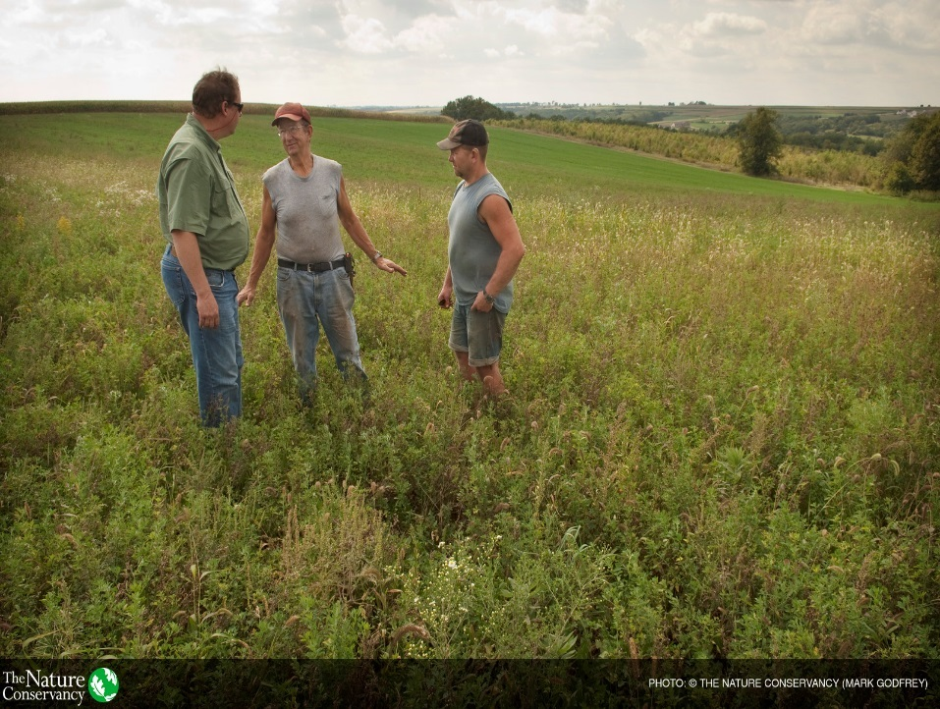
Regional Conservation Partnership Program
Conservation partnerships
$100 million annually plus 7% of easement, EQIP, Healthy Forest Reserve, and CSP funding
Partnerships are competitively awarded

Slide 15
California’s Share 2014-2017: $110 M/year
Stewardship
  EQIP $341M
  CSP $ 25M
  RCPP $ 15M
Easements
  ALE $ 29M 43K acres (federal share, matched at least 1:1)
  WRE $ 28M 13K acres (no match, federal easements)

Slide 16
California’s Share: Why so small?
Less than 2% of annual conservation title funding
1/50th…
Even though:
  Largest state by population
  Third largest state by area
  15th most private agricultural land of any state
  Our irrigated land alone is bigger than 9 entire states
  More listed species than almost any other state

Slide 17
California’s Share: What to do?
Find:
  Partners
    Make sure Farm Bill $$$ goes to agricultural producers/landowners
  Matching funds

Slide 18
Trends over past two Farm Bills
In Conservation title, specifically, increasing support for:
  collaborative partnerships
    greater role for third parties
    flexibility to innovate
  targeting resources to address regional resource challenges
  coordinating work among multiple landowners in a landscape
  emphasis on “both/and” outcomes, rather than “either/or”

Slide 19
Current state of play
House Agriculture Committee
  Draft bill: any day now
  Mark up: before end of March
Senate Agriculture Committee
  RCPP bill introduced by Senators Stabenow and Ernst
  Draft Farm Bill: not yet
  Mark up: not set
Current Farm Bill expires in September 2018
  Drivers: SNAP and winter wheat

Slide 20
Rumors
CSP will end
  resources will be reallocated to other programs
Increased funding for partnerships and easements
  Funding for RCPP will increase
    RCPP will get its own “baseline” funding
  Funding for ACEP will increase

Slide 21
Upshot for California
Potentially good
Conservation programs most relevant to California likely to grow
Increased funding for flexible tools
Increased roles and opportunities for local land trusts

Slide 22
California is different:
Agricultural economy and trends
Number one state in value of annual ag production
  $45B in 2016
Specialty crops dominate
  Nuts, fruit, vegetables
Up to 10 million acres of irrigated farmland
  1 million acres of almonds
Roughly 20 million acres of private rangeland
Conversion of annual crops and rangeland to trees and vines

Slide 23
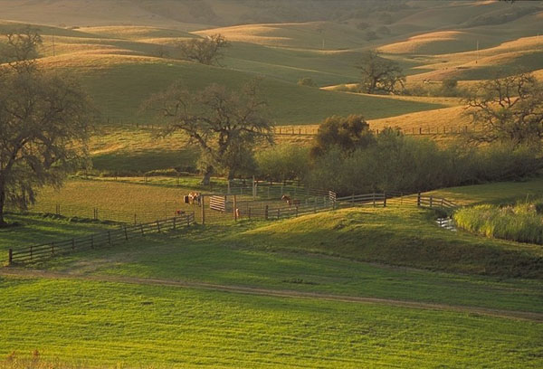

Slide 24
California is different:
Key resource challenges
Groundwater sustainability
Drought resilience
Floodplain restoration—dual purpose: water supply and flood damage
Seasonal habitat for migratory species
Endangered species habitat
Flows for native fish—including salmon

Slide 25
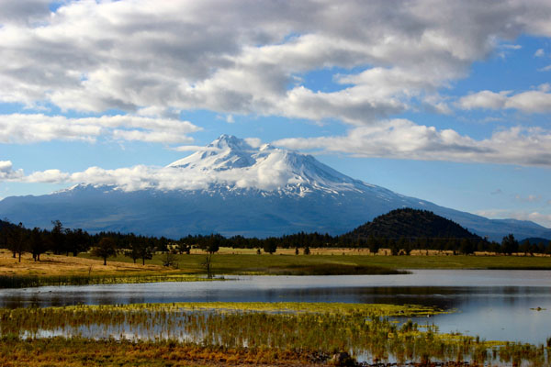

Slide 26
California is different:
Need innovation and new tools
Annual crop easements
  Fallow during drought
  Flood for seasonal habitat during winter
Short term contracts
  Seasonal habitat for migratory birds
Proactive floodplain easements
  Restore habitat
  Reallocate flood storage space behind dams

Slide 27
Californians on House Agriculture
Republicans
  Rep. La Malfa
  Rep. Denham
Democrats
  Rep. Costa
  Rep. Panetta

Slide 28
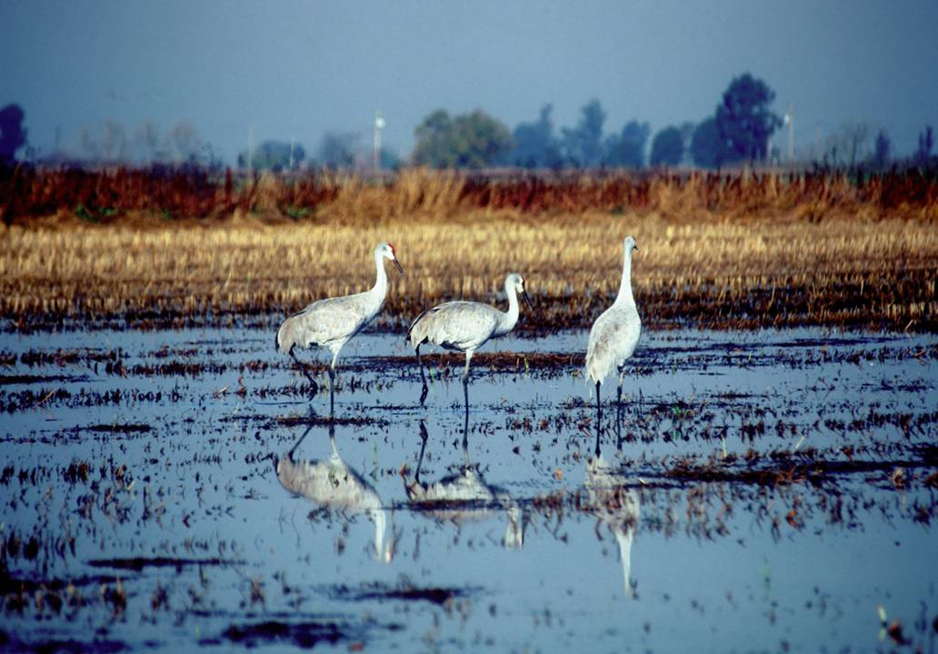
Discussion

